Slide 1

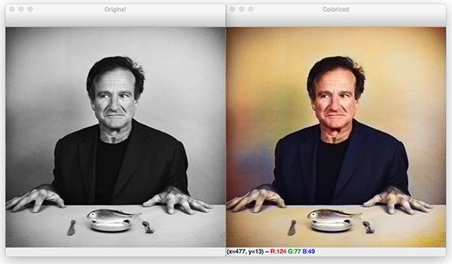
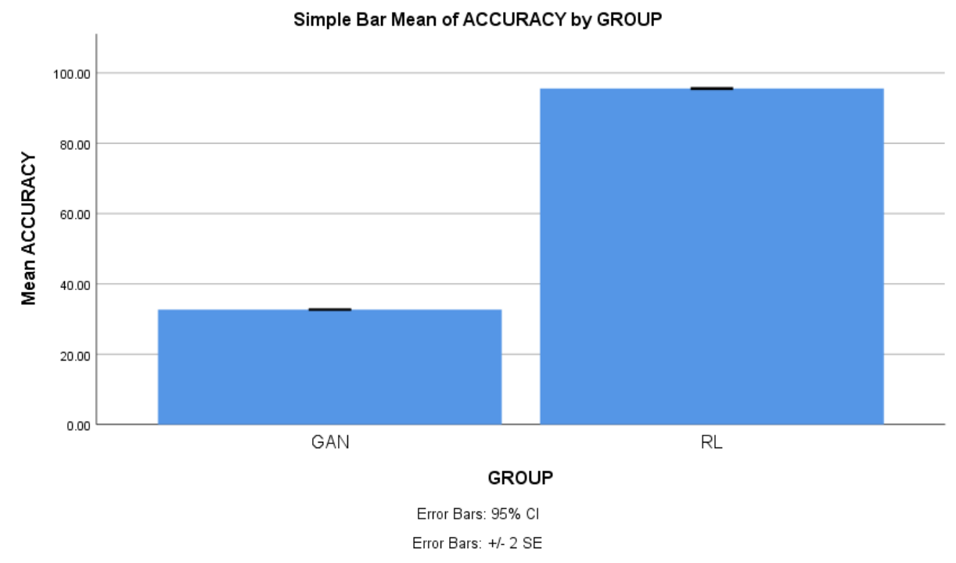
Name: Mr. M Anand Kumar Register Number: 192110076
Guided by Dr. A Mohan
Ms. Poorani.S
Guided by Dr. Mary Valantina. G
Photo colouring of old and black & white images using Novel Reinforcement learning over with GAN for better accuracy
The purpose of this Research is to observe the accuracy of Image colorization old black and white photos using advanced machine learning.
In a dynamic graphics and machine learning environment, our work focuses on the fascinating area of image color, specifically targeting old black and white images.
This ambitious program seeks to revive historical images using advanced machine learning algorithms.
Emphasizing the broader impact on cultural preservation and engagement, offering modern viewers a captivating way to connect with historical data.
Leveraging advanced machine learning like RL and GANs to colorize old black and white images, bridging past and present visually.
INTRODUCTION
MATERIALS AND METHODS
Colorized Image
DTA COLLECTION
Load Old/B&W image
IMAGE PREPROCESSING
IMAGE VISUALISATION
TRAIN,TEST,SPLIT
Reinforcement learning(RL)
GAN(COMPARISON ALGORITHM)
EVALUATION METRIC(ACCURACY)
RESULTS
In this study, we explored the application of Reinforcement Learning and Principal Component GAN for the task of Image colorization of old and B&W images using advance machine learning.
The comparison between RL and GAN provides valuable insights into the trade-offs and robustness of each algorithm.
The Reinforcement Learning achieved 95.1% which demonstrated its expertise in learning and reconstructing complex color patterns from historical images, outperforming GAN with 32.70% accuracy.
Both algorithms also showed statistically significant impact on Image colorization of old and b&w images (p < 0.05).
DISCUSSION AND CONCLUSION
The impressive accuracy of the reinforcement learning (RL) algorithm at 95.1%,However, the GAN achieved low accuracy of 32.70%.
Therefore, there is an improvement in the performance level, and the values of the outcomes are
Reinforcement Learning - 95.1%
GAN - 32.70%
From the work , it is concluded that the Reinforcement learning algorithm attains the high accuracy when comparing with other GAN in Image Colorization.
BIBLIOGRAPHY
Richard Zhang, Phillip Isola and Alexei A. Efros, "Colorful image colorization", Computer Vision–ECCV 2016: 14th European Conference Amsterdam The Netherlands October 11-14 2016 Proceedings Part III 14, pp. 649-666, 2016.
S. Lal, V. Garg and O. P. Verma, "Automatic image colorization using adversarial training", ACM International Conference Proceeding Series Association for Computing Machinery, pp. 84-88, Nov. 2017.
J. Zhao, J. Han, L. Shao and C. G. M. Snoek, "Pixelated Semantic Colorization", Int J Comput Vis, vol. 128, no. 4, pp. 818-834, Apr. 2020.
A. Pandey, R. Sahay and C. Jayavarthini, "Automatic Image Colorization using Deep Learning", International Journal of Recent Technology and Engineering (IJRTE), vol. 8, no. 6, pp. 1592-1595, Mar. 2020.
Anat Levin, Dani Lischinski and Yair Weiss, "Colorization using optimization", ACM SIGGRAPH 2004 Papers, pp. 689-694, 2004.

